Slide 1





SMART GARDEN
By
M Shaharyar Shabbir

Slide 2

Abstract
The Smart Garden System is a networked garden automation system that utilizes various sensors and devices to monitor and control the environment and plant growth. The system is designed to optimize plant growth, conserve water, and automate the garden's irrigation process.
The Smart Garden System with Water Sensor, Sprinkler, Motion Sensor, and Gate offers a reliable, efficient, and convenient way to manage and maintain a garden. The system's scalability and flexibility make it suitable for small-scale and large-scale garden applications

Slide 3



Introduction
A smart garden system with components such as a water level monitor, sprinkler, door, and sensor is an example of an IoT-based project that can automate and optimize various functions related to garden maintenance, security, and environmental sustainability.
The system uses sensors to monitor and control the environmental conditions of the garden. The water level monitor can detect when the soil is dry and trigger the sprinkler system to water the plants only when necessary, preventing overwatering and waste of water.
The gate can be controlled remotely, allowing the user to restrict access to the garden and enhance security.
A smart garden system is an excellent example of how IoT technology can be used to create a more efficient, sustainable, and enjoyable gardening experience for the user.

Slide 4
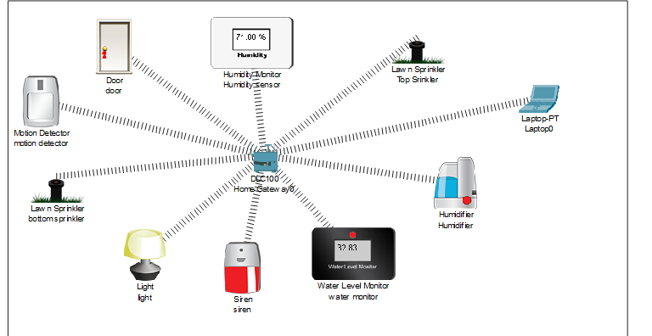
DESIGN WITH MODULES DESCRIPTION
Smart Garden System

Slide 5
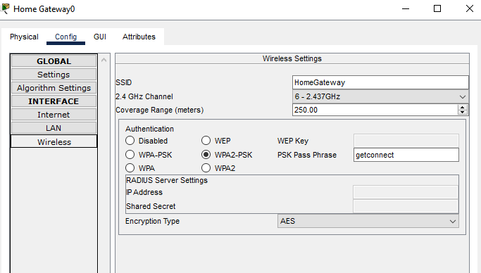
CALCULATIONS AND IMPLEMENTATION
Home gateway is connected to all the devices present in the system through wireless network connectivity. The IPv4 address is 192.168.25.1 and the subnet mask is 255.255.255.0 .
The authentication for this is WPA2-PSK. With the help of password ‘get connect’ we will connect all the devices.

Slide 6
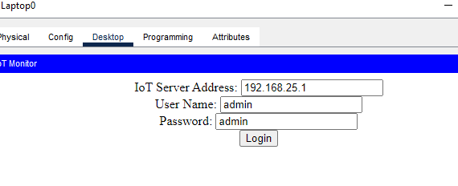

CALCULATIONS AND IMPLEMENTATION
With the help of Laptop we will open the IOT monitor gateway . To open it we will go to the web browser and enter the IP address ( 192.168.25.1 ) in the URL.
Now we will login using the Username ( admin ) and password ( admin ).

Slide 7

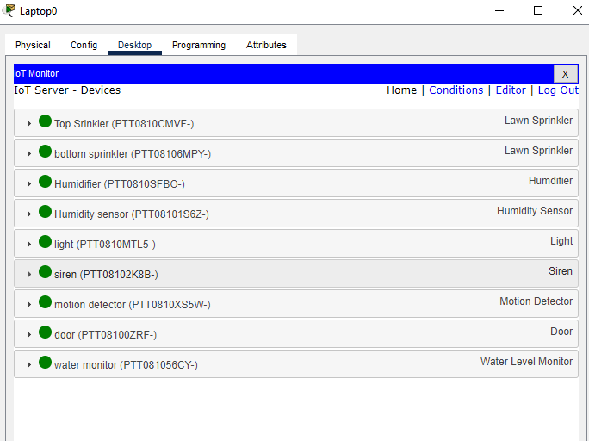


CALCULATIONS AND IMPLEMENTATION
In the monitor gateway we will get the different types of devices that are connected to the home gateway.
Next we will apply conditions according to our need.

Slide 8
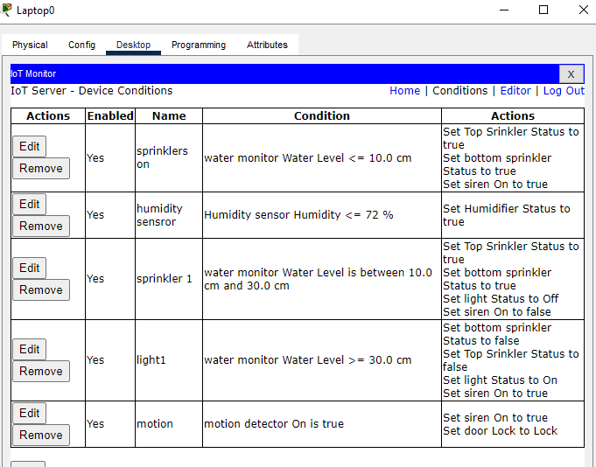
CALCULATIONS AND IMPLEMENTATION
Conditions.
Water Level
If the water level is less than 5.0 cm then all the sprinklers will be on. If the water level present in the soil is more than 30 cm then all the sprinklers will be off.
Humidity Level
If the humidity present in the atmosphere is more than 72% then the humidifiers are set to off. If the recorded values in the humidity sensor are less than 72%then the humidifiers are set to on.
Smart Light
If the water level is less than 5.0 cm then the smart light is turned on. If the water level present in the soil is more than 5.0 cm then the smart light is turned off. And if water Level is more than 30.0 cm then smart light will be on.
Motion Detector
The motion sensor detects any movement within the garden area and sends a signal to the sprinkler to switch to turn it off.

Slide 9
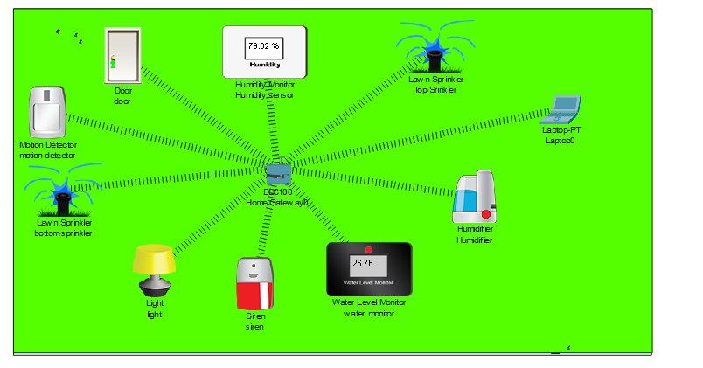
Implementation

Slide 10





INFERENCE
In conclusion, the Smart Garden System project is an innovative technology that combines automation, data analysis, and customization to improve gardening practices.
The use of components such as sprinklers, water level monitors, sensors, and gates enables the system to monitor and respond to environmental factors in real-time, resulting in efficient use of resources and better plant growth.

Slide 11
JAZAK ALLAH KHAIR !

